Slide 1


Slide 2


Slide 3

Microsoft Project Blue Mountain 2024
Solving the
Housing Crisis
in Jamaica

Slide 4

The problem
150,000
Units of houses short
142 out of 146
Highest electricity charges globally

Slide 5

What’s causing the crisis?
High Construction Costs
Little Incentive from Developers
Speculative Real Estate

Slide 6
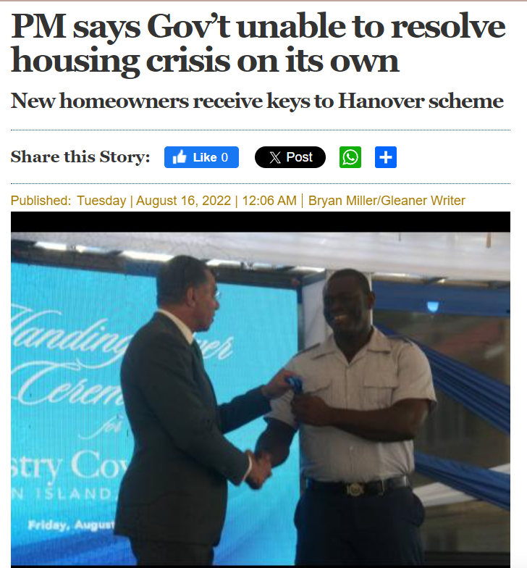
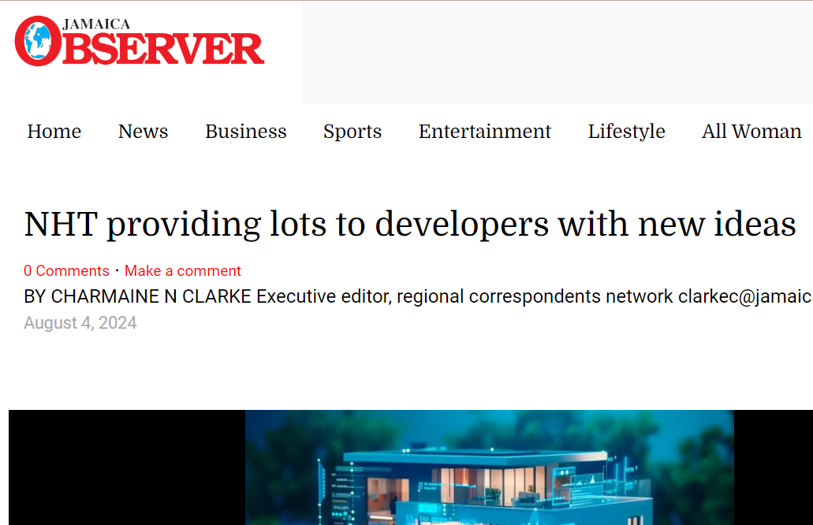

Slide 7

Introducing
Build better, live better

Slide 8


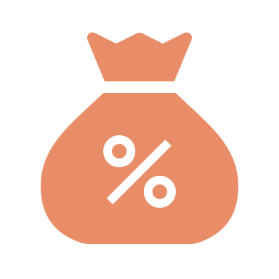

The Solution We partner with businesses to build homes that are affordable ,modular and environmentally sustainable
Lower price
Improved benefits
Good returns
Cleaner energy
For buyers
For businesses
For investors
For the planet

Slide 9
Mission Statement
Our mission is to provide sustainable, affordable housing solutions that empower low-to-middle-income families to achieve homeownership. Through innovative modular design and strategic partnerships, we aim to reduce housing costs while promoting energy efficiency and environmental stewardship.

Slide 10

What We Do
Manufacture gypsum panels
Manufacture modular components
Transport and assembles units

Slide 11
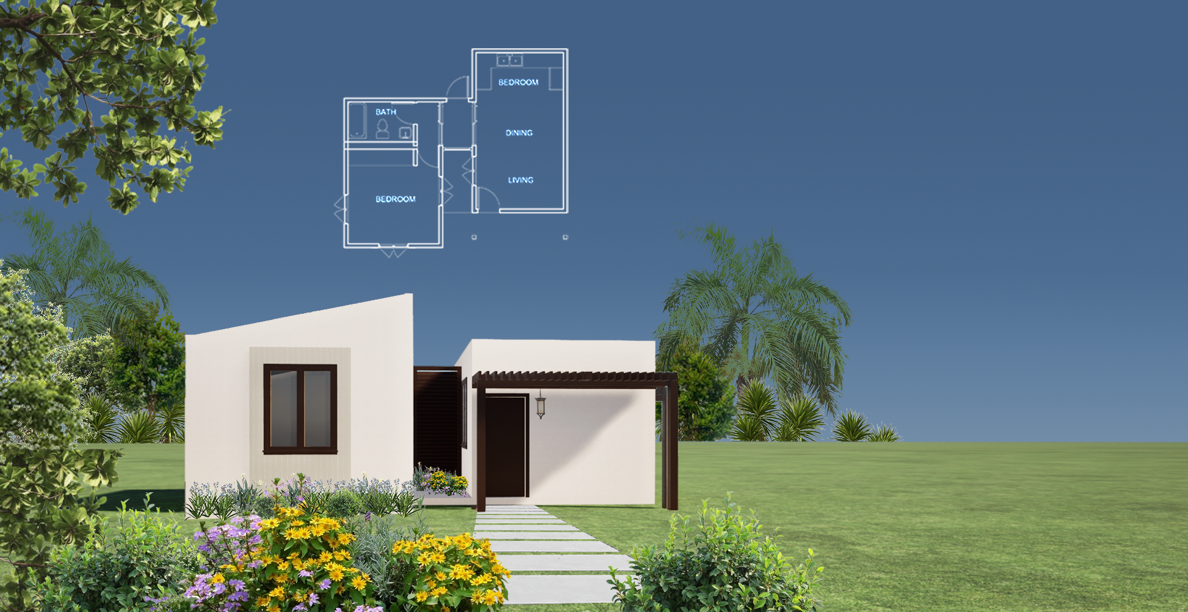
The Design
Rainwater Harvesting
Built in solar panels
Passive Ventilation
Melting Pot

Slide 12
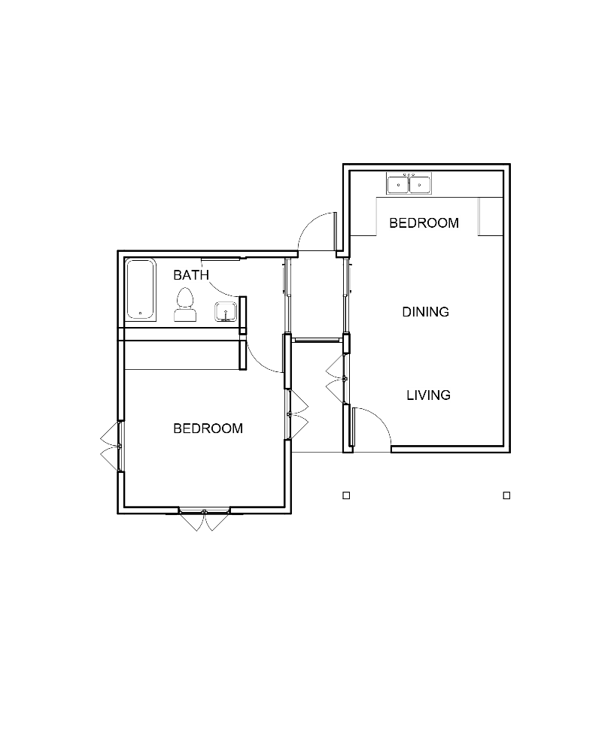
Modularity
KITCHEN
TYPICAL 1 BEDROOM UNIT
FLOOR PLAN
MODULES AND UNIT COMPOSTIONS
TYPICAL 2 BEDROOM UNIT

Slide 13

How it works
Minimum order goal
Production of material and components begins in our factory
Components transported and assembled

Slide 14
Traditional vs Modular
Traditional Construction
100% on-site, leading to longer build times (12-18 months).
100% on-site labor, requiring skilled workers, increasing total project costs.
Material waste due to inefficiencies on-site.
Solom Modular Construction
60-70% faster (3-6 months) as modules are built off-site in controlled environments.
10-15% lower labor cost due to reduced labor and shorter construction times.
80% fewer vehicle movements needed to development sites

Slide 15
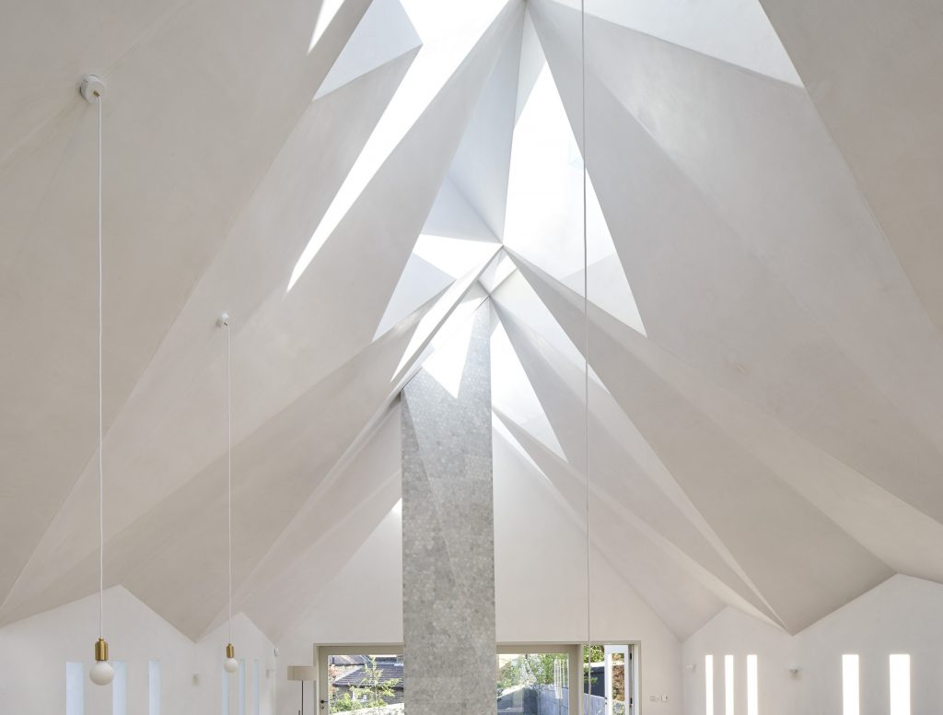
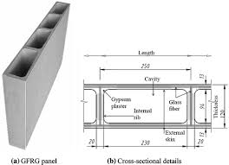
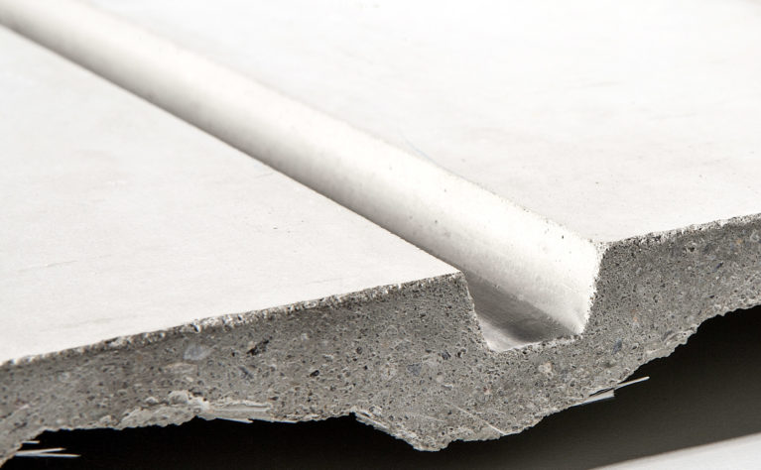
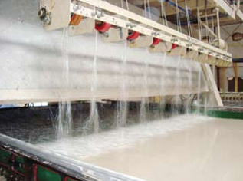
Out with the old The Future of Construction
Glass Fiber Reinforced Gypsum (GFRG)
Fire-resistant up to 1000°C
Earthquake and Hurricane Resistant
Naturally cooler up to 4°C
Eco-Friendly
Mineral sector comprises of 75% of Jamaica’s exports

Slide 16
Market Size
US$88.94bn
US$72.25bn
US$360 M
Jamaican Real Estate TAM
Jamaican Real Estate SAM
Solom Market Size

Slide 17
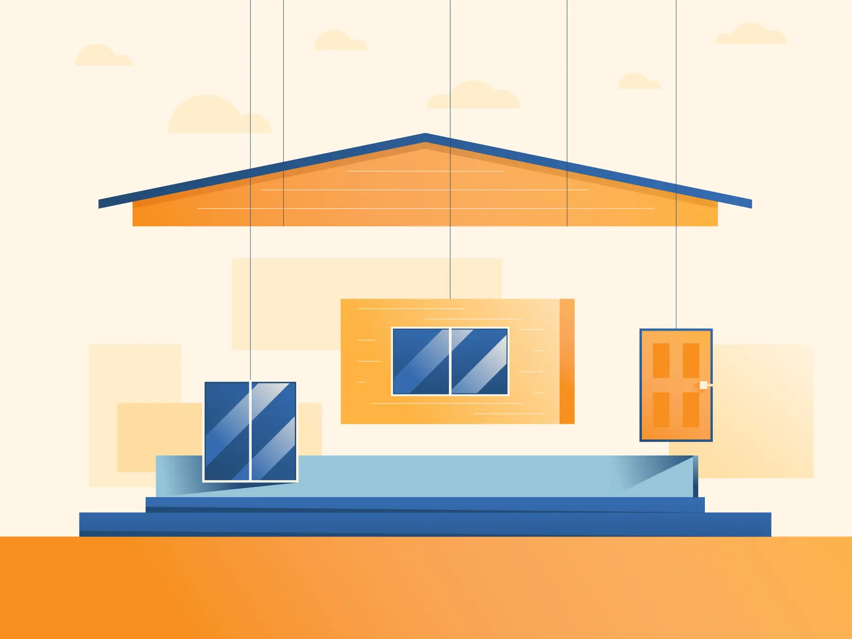
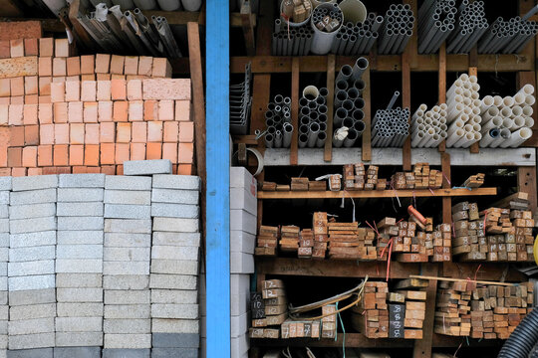

How we cut cost
Pre fabrication
Innovative materials
Partnerships

Slide 18

Business Collaboration
Win-Win: Employees get affordable homes with long-term utility savings, businesses offer a valuable employee benefit,
We scale housing production with guaranteed buyers. This boosts employee retention, satisfaction, and social impact.
Notes:
Partnering with Businesses: We collaborate with companies that want to offer affordable housing solutions as a benefit to their employees.
Employee Housing Packages: Through the partnership, employees gain access to specially designed modular homes at discounted rates, making homeownership more attainable.
Cost Reduction: We reduce overall construction costs through bulk orders and subsidies, passing those savings directly to the employees.
Win-Win: Employees get affordable homes with long-term utility savings, businesses offer a valuable employee benefit, and we scale housing production with guaranteed buyers. This boosts employee retention, satisfaction, and social impact.

Slide 19


What Makes Us Unique?
55% locally sourced materials
Built in sustainability
Prefab permanent houses
Innovative Financing Structures

Slide 20
Our Business Model
Revenue Streams
Cross-Subsidization Model: 70% of homes sold at affordable rates (targeting low- to middle-income families).
30% sold or rented at market rates
Government subsidies and tax Incentives
Cost Structure
Modular Construction: Use of modular construction techniques reduces build time and costs by up to 30%.
Economies of Scale: By adopting a minimum order system
Business Partnerships: Reduce marketing and sales expenses

Slide 21
Cost and Revenue
Category | Affordable Units ($60k) | Market Price Units ($90k-$100k)
Cost per Unit | $50,000 | $60,000
Revenue per Unit | $60,000 | $90,000 - $100,000
Gross Profit per Unit | $10,000 | $30,000 - $40,000
Production Costs
- Material Costs | $30,000 | $40,000
- Labor Costs | $10,000 | $10,000
- Factory Overheads | $5,000 | $5,000
- Distribution/Logistics | $2,000 | $2,000
- Other (Admin, Utilities) | $3,000 | $3,000
Total Production Costs | $50,000 | $60,000
Number of Units Sold (Assumed) | 70 affordable units | 30 market-priced units
Total Revenue (Per 100 Units) | $4,200,000 (70 x $60k) | $2,700,000 - $3,000,000 (30 x $90k-$100k)
Total Cost (Per 100 Units) | $3,500,000 (70 x $50k) | $1,800,000 (30 x $60k)
Total Gross Profit (Per 100 Units) | $700,000 | $900,000 - $1,200,000

Slide 22

Guarantee Affordability
Tier System
Maximum income limit to be eligible to purchase a home within that tier.
Cap on Profit: If the owner decides to sell, there is a cap on how much they can profit from the sale.
Notes:
Prevents real estate speculation by capping income limits, keeping homes affordable for low- to middle-income families.

Slide 23
Milestones Where and when are we going
Stage 5
Extension
Expand market to commercial buildings
Explore expansion into new regions or countries facing similar housing crises.
Develop new modular housing models tailored for specific markets or climates.
Integrate more advanced eco-friendly technologies, like smart home energy monitoring.
Stage 1
Research and Development
Identify and secure land for prototype construction.
Get feedback from key stakeholders.
Apply for any necessary permits and certifications.
Stage 2
Crowdfunding
Campaign page
Public Relations
Partners and Investors
Stage 3
Introduction
Acquire factory and machinery
Execute marketing campaigns Preorders
Stage 4
Growth
Expand production
Focus on optimizing logistics and reducing lead times
Additional partnerships with more businesses and government entities.
Time

Slide 24


The Team
Kemona Nelson
Architecture Student
Sherissa Pinnock
Computer Science Student

Slide 25

The Ask
We are seeking $1 million in seed funding to scale our operations over the next 12 months.
Let's discuss how you can be part of our growth journey.

Slide 26
Affordable Housing
Is Profitable

